Slide 1
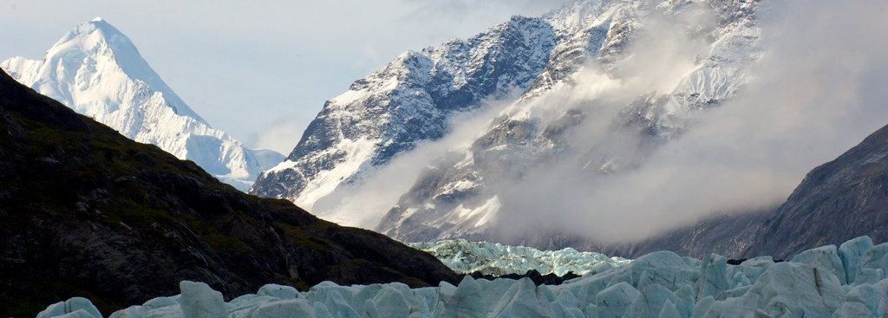
A Study of the Heating Temperature in the
Major Cities in the World through
Data Mining in MongoDB
Notes:
Current paper title

Slide 2
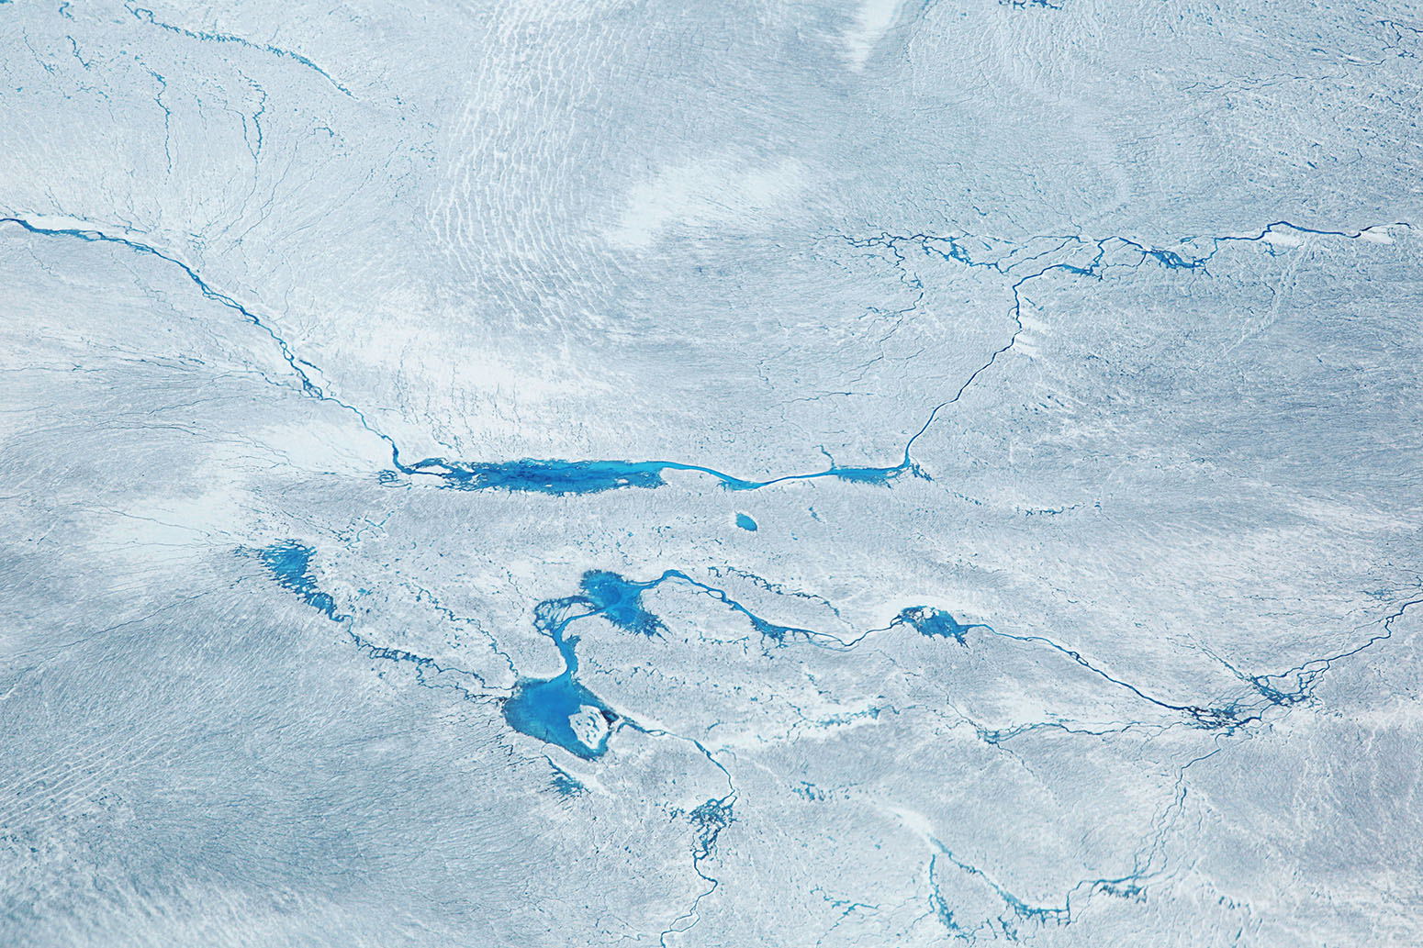
CONTEXT OF THE STUDY
The motivation behind the conduct of research:
To help provide increased public awareness of
Climate change
Global warming
Text mining on a big data scale with the use of MongoDB

Slide 3
RESEARCH QUESTIONS
How much in average temperature is the climate change in the world for the past 10 years? (Excluding 2017)
What was the hottest and coldest average temperature 10 years ago?
Which country and its city has the hottest temperature in 2016?
Which country and its city has the coldest temperature in 2016?
Notes:
Because latest available data with RRL and supporting institution’s facts is only for 2016.

Slide 4
RESEARCH OBJECTIVES
The study aims:
To determine the average increase and/or decrease of temperature in the world per:
Year
Country
To Identify which CITIES has the most significant increase in temperature and the hottest by year 2016.
To find out which CITIES has the most significant decrease in temperature and the coldest by year 2016.
To establish a model that projects these statistics that is propelled by MongoDB

Slide 5
SCOPE and LIMITATION
The research focuses on finding out how devastating the climate change is in the major cities of the world, specifically the rising temperature in our lands and some of its effects that has already taken place in our society.
The research covers the average increase or decrease of temperature in relation to global warming . Taking into consideration the past ten years from the file, where 2016 marks the tenth year for the study.
On account of the latest available recorded facts as per NASA on their latest annual average Global Temperature data which can be found in their website.

Slide 6
SIGNIFICANCE of the STUDY
The contribution of the study to Computer Science and Information Technology shares the use of MongoDB as the repository of big data and the model established for the research.
The research can help concerned government and non-government agencies around the world in their campaigns to help provide increased awareness and policies for the endless effort to battle climate change.

Slide 7

REVIEW of RELATED LITERATURE
[1] Usui, K. (2014). Marketing and Consumption in Modern Japan, 130.
[2] Clare H. Redshaw, Will M. Stahl-Timmins, Lora E. Fleming, Iain Davidson & Michael H. Depledge (2013). Potential Changes in Disease Patterns and Pharmaceutical Use in Response to Climate Change, Journal of Toxicology and Environmental Health, Part B, 16:5, 285-320.
DOI: 10.1080/10937404.2013.802265
[1] In Japan, housewives would still visit nearby shops multiple times a week to buy food in small amounts. This is due to several factors they consider such as the size, shape and quality of the product, which are not pre-packed and does not have constant pricing and quantity. Those aforementioned facts, aside from other conditions, mainly depend on the weather that may mean getting less than expected from the previous days caused by climate change.
[2] Global warming heats up not only the temperature but also the intensity, occurrence and frequency of heat waves. This in turn increases incidents of non-communicable diseases such as heat stress that eventually leads to fatality. Which is the case during recent summers Europe where thousands died because of the said phenomena
Notes:
RRL for the topic.
No RRL checked mongoDB yet.

Slide 8
REVIEW of RELATED LITERATURE
[6] Hanen Abbes & Faiez Gargouri (2016, September). Big Data Integration: A MongoDB Database and Modular Ontologies based Approach.
DOI: 10.1016/j.procs.2016.08.099
[7] Boicea, A., Radulescu, F., & Agapin, L. I. (2012, September). MongoDB vs Oracle--database comparison. In Emerging Intelligent Data and Web Technologies (EIDWT), 2012 Third International Conference on (pp. 330-335). IEEE.
MongoDB database
There is numerous database technology to choose from but considering massive volume of datasets for research, the scalability and the ability to use containers to deduce a schema aside from being an open-source system, MongoDB is really one of the best option. A feature to consider from this NoSQL type of database is the capability of server replication and sharding of enormous datasets.
Believed to be one of the fastest-growing database in the field of information technology, MongoDB also features a rapid handling of load when it comes to big data. The typical operations of our databases such as inserting, updating and deleting rows and tables has a very consistent high-speed processing of data when it comes to large amount of records [6,7].

Slide 9
REVIEW of RELATED LITERATURE
(continuation)
Table 1. Operation times comparison(msec)
No. of Records | Oracle Database |  |  | MongoDB
 | Insert | Update | Delete | Insert | Update | Delete
10 | 31 | 453 | 94 | 800 | 1 | 1
100 | 47 | 47 | 47 | 4 | 1 | 1
1000 | 1563 | 47 | 62 | 40 | 1 | 1
10000 | 8750 | 94 | 94 | 681 | 1 | 1
100000 | 83287 | 1343 | 1234 | 4350 | 2 | 1
1000000 | 882078 | 27782 | 38079 | 57871 | 3 | 1

Slide 10
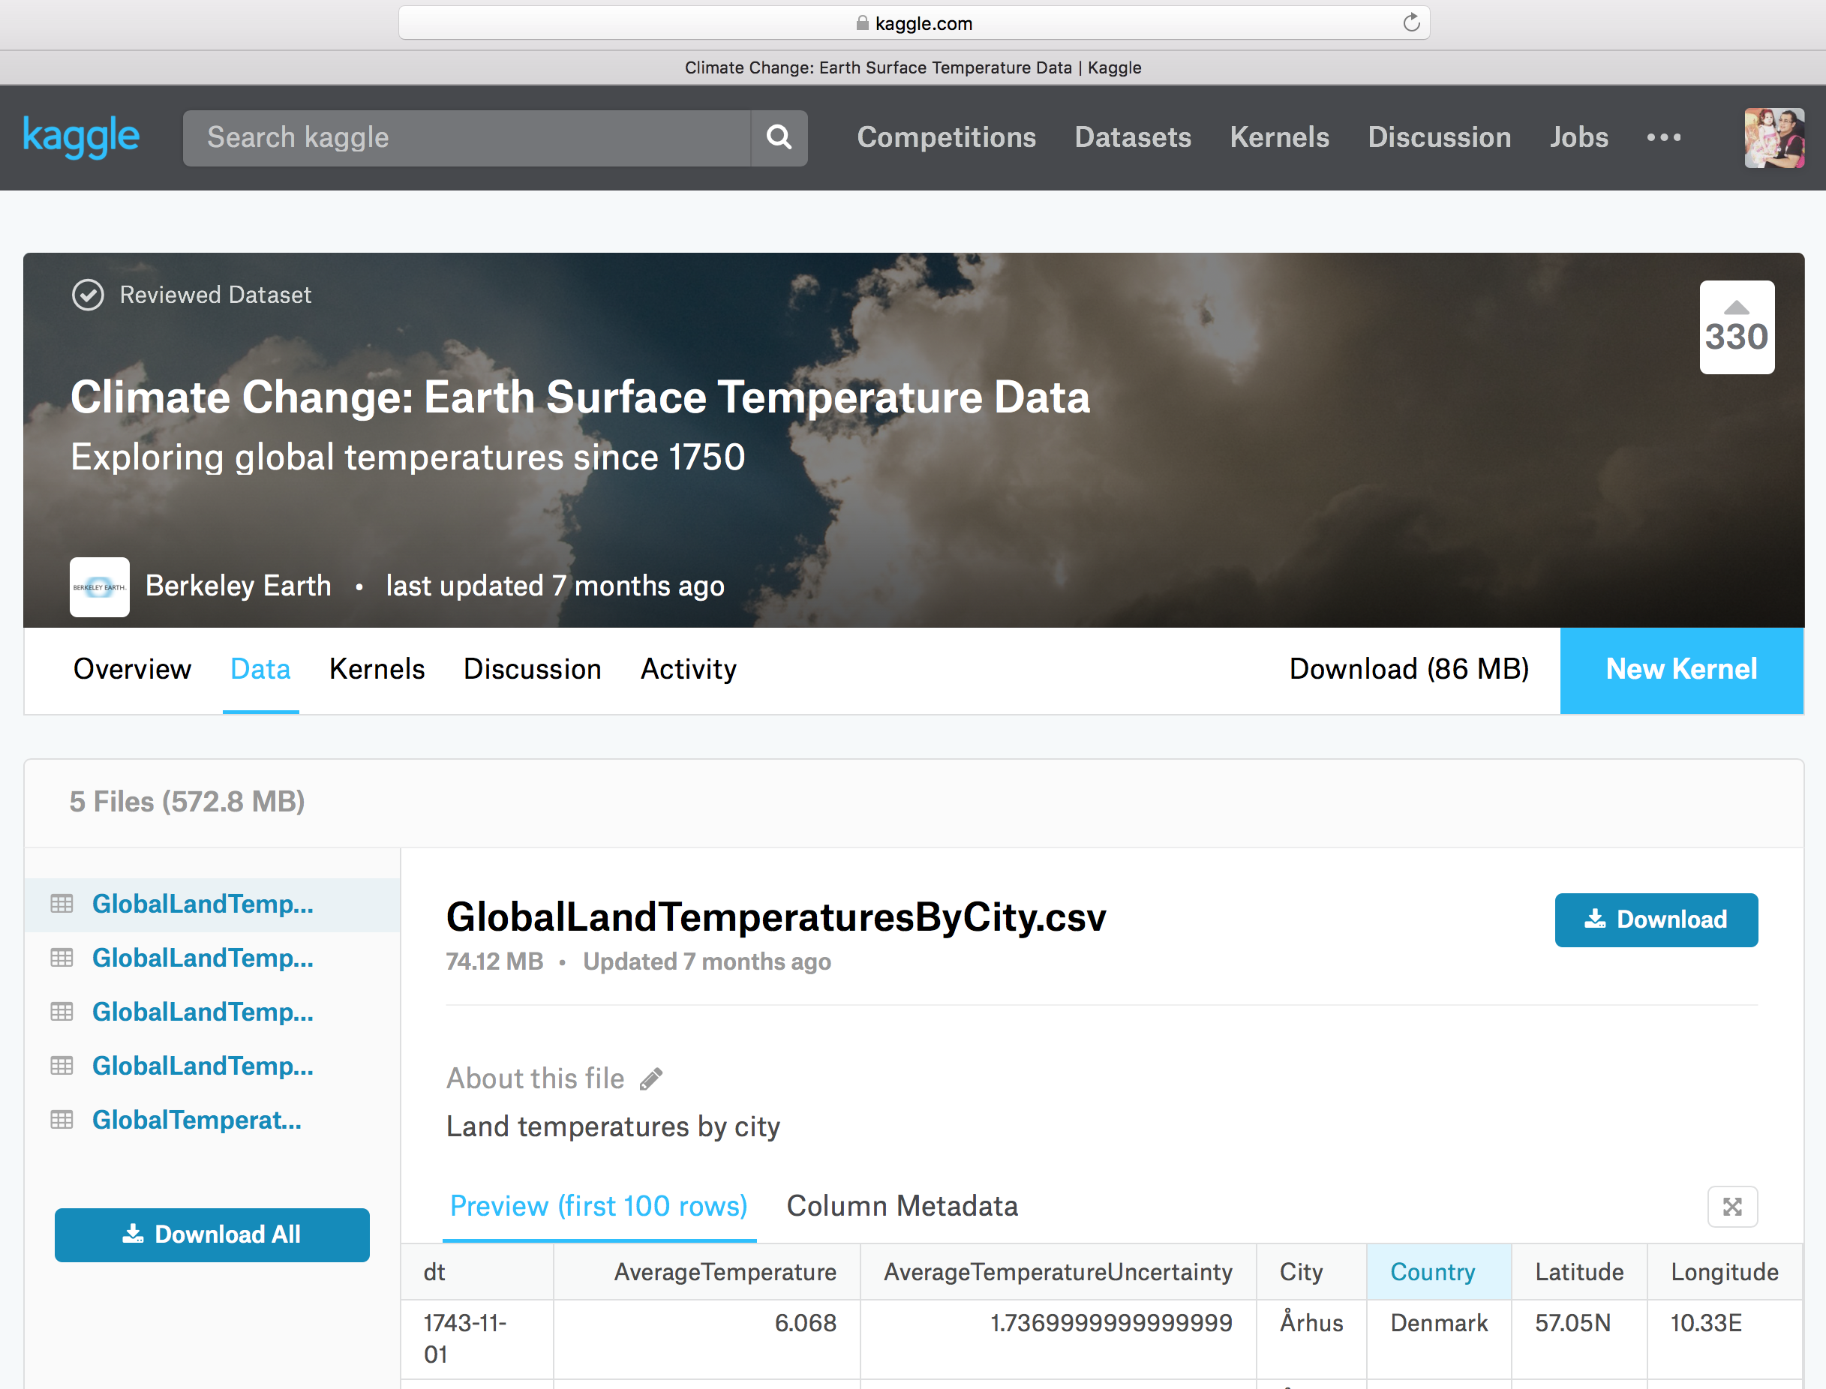
METHODOLOGY
The researchers were able to obtain the dataset from Kaggle.
Notes:
Started by looking for a dataset that has features for climate change.

Slide 11
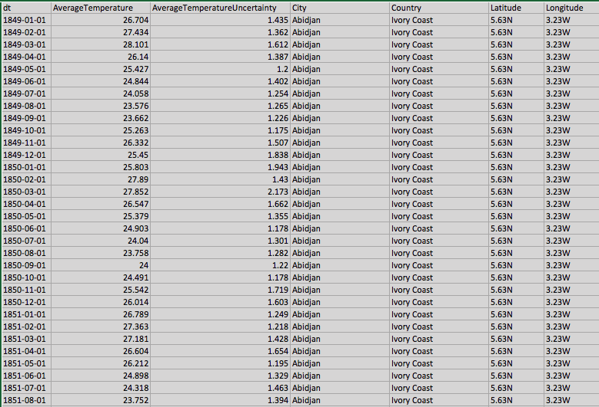
RAW DATASET
(preview)
Notes:
Raw dataset : Kaggle.com <Berkeley Earth account>
“this is how the dataset looked like after downloading the csv file.”

Slide 12
METHODOLOGY
(continuation)
The dataset was then pre-processed Manually and by using a Java designed cleaner.
STEPS (Manual):
Removed AverageTemperatureUncertainty
Removed other Year data
Retained data: for year 2006 to 2016 only
STEPS (Automated):
Loaded the CSV file in eclipse/program.
Mapped attributes (JSON) to corresponding fields.
Supplemented features based on facts:
Continent (labeled as ‘Region’)
Sub-Region

Slide 13
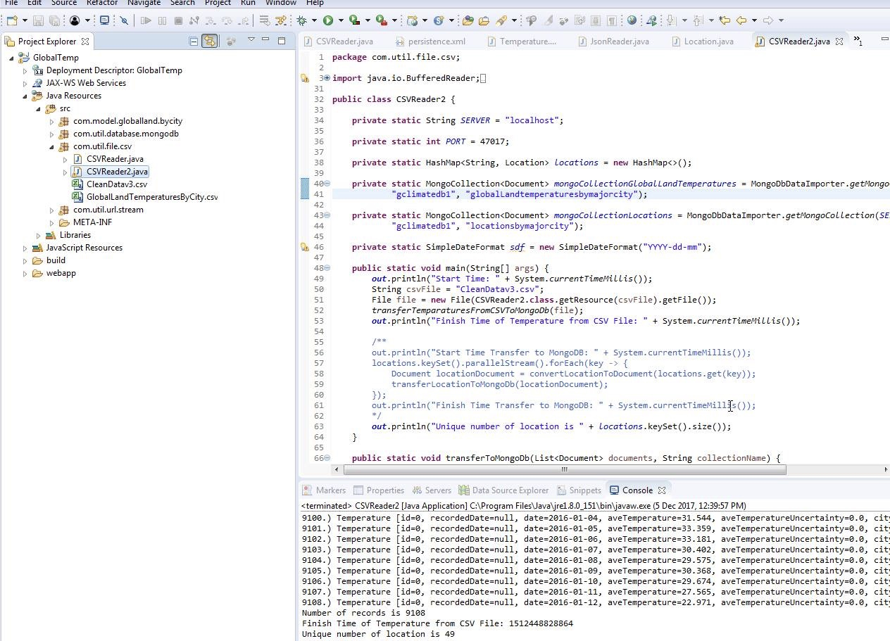
ECLIPSE: JAVA PRE-PROCESSING

Slide 14
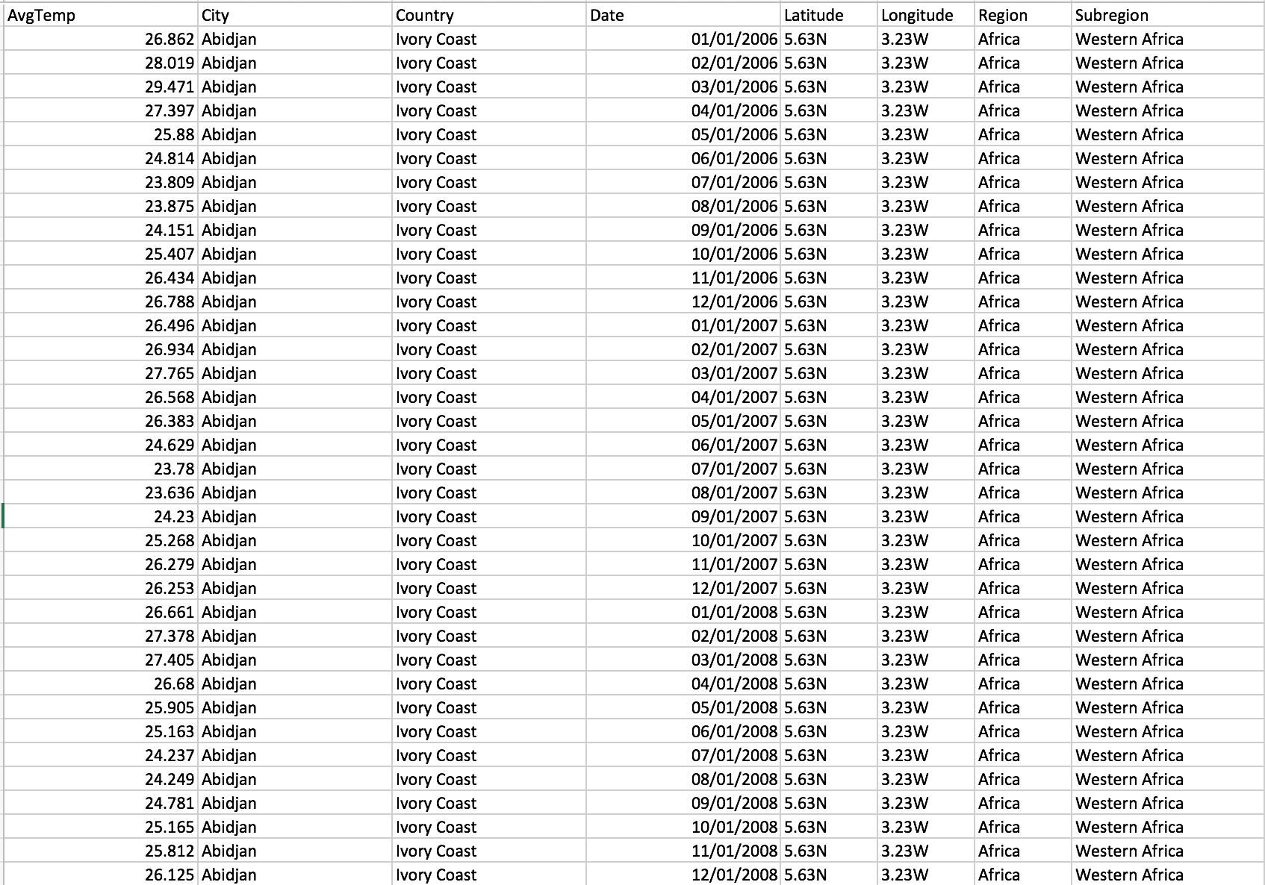
PRE-PROCESSED DATASET
(preview)
Notes:
This is the pre-processed dataset ran through the java program that added the Region and Sub-Region features.

Slide 15
METHODOLOGY
(continuation)
MongoDB setup:
Config Server
Shard Server
Mongos
Dataset Import
SEE SETUP.JS file for details

Slide 16
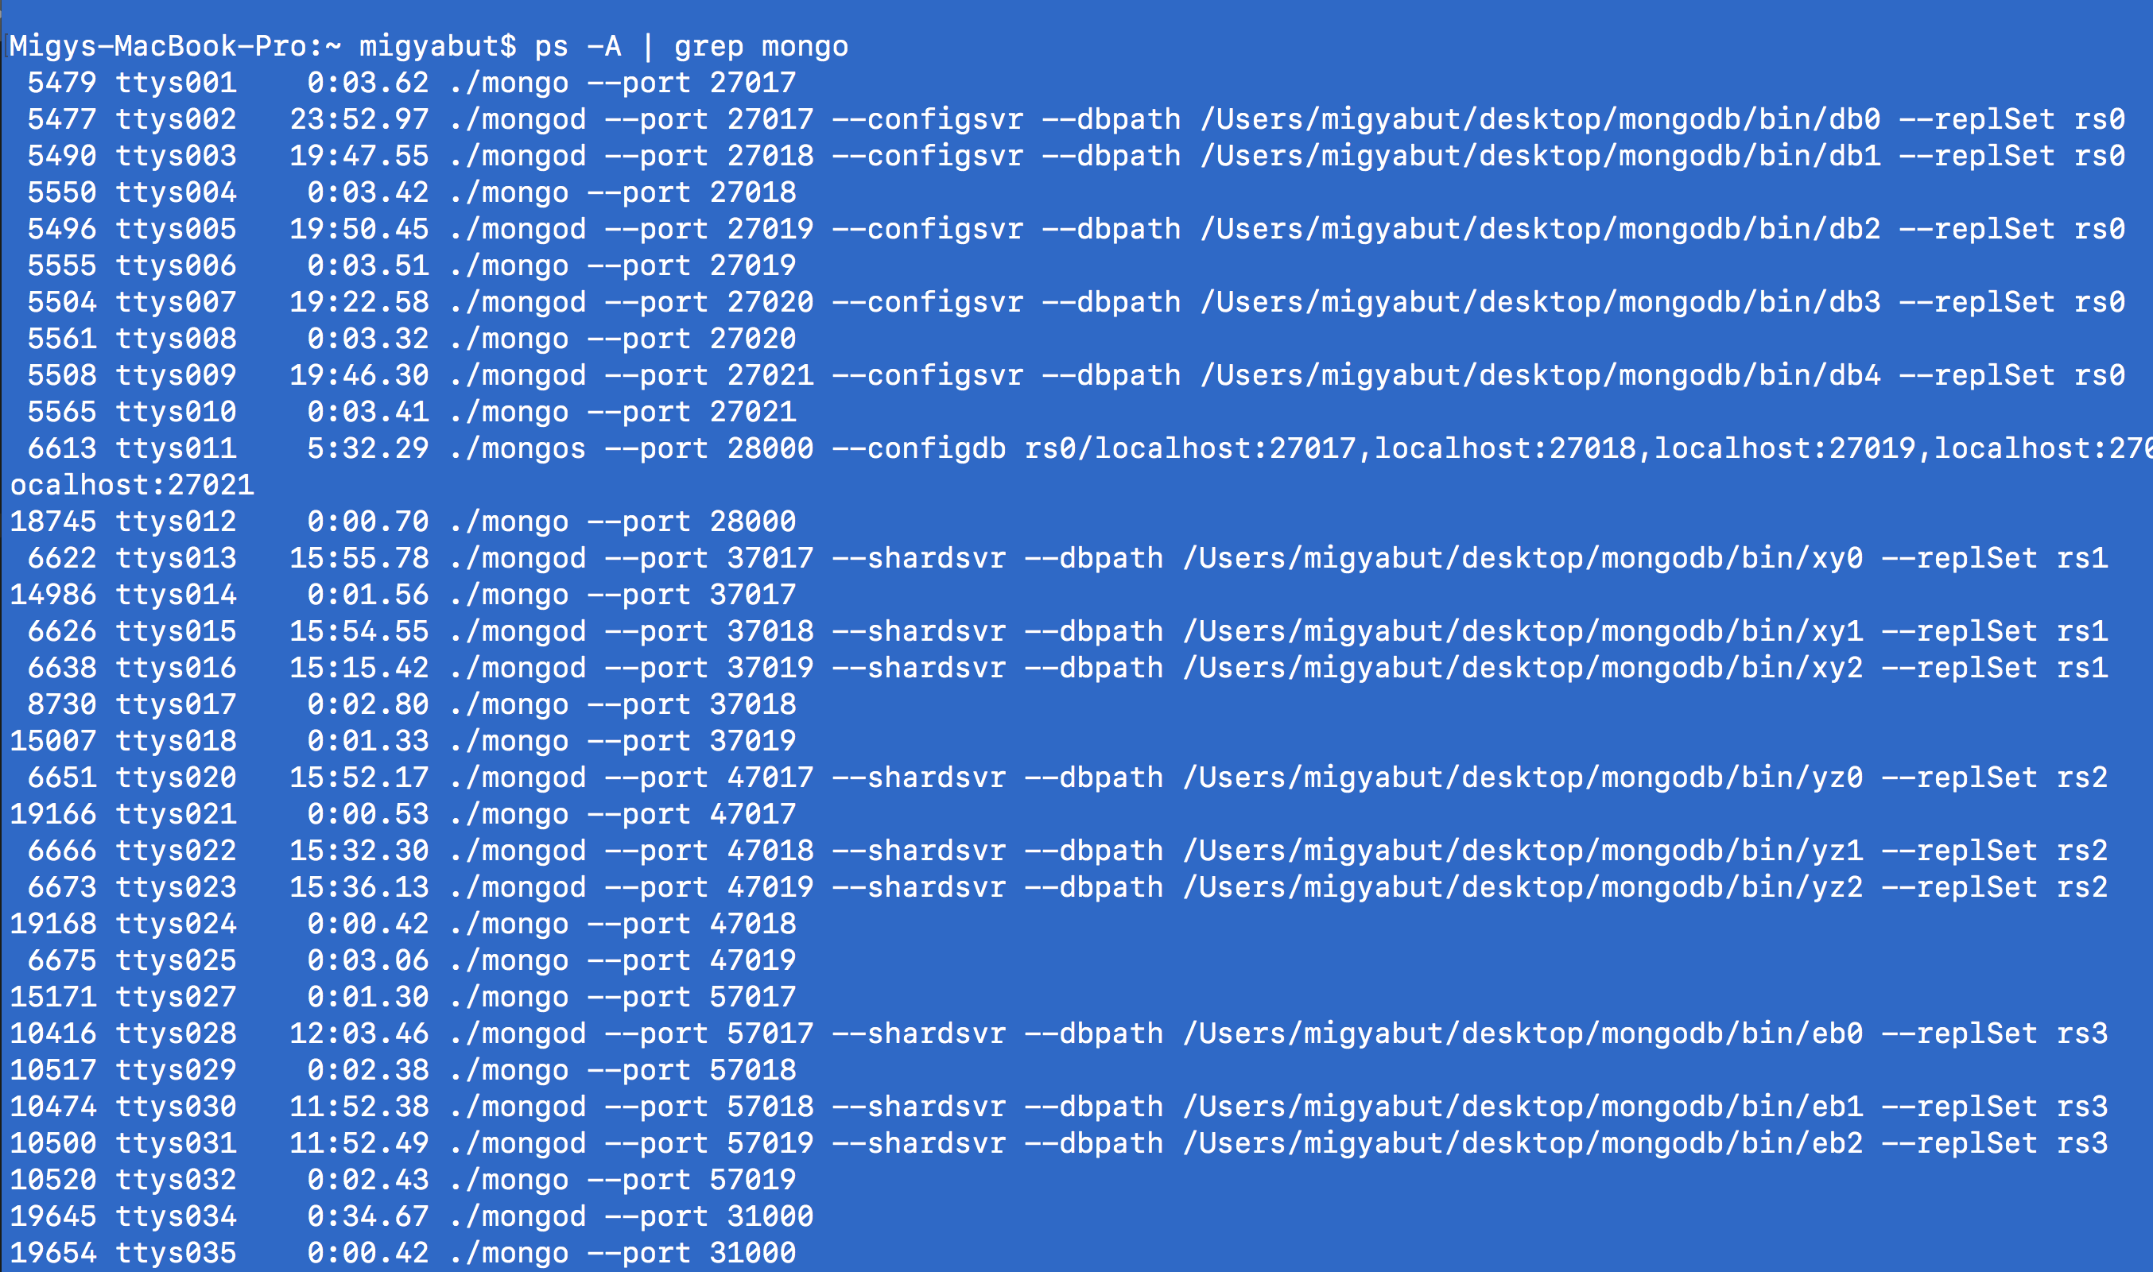
CONFIG & SHARD SVR SETUP

Slide 17
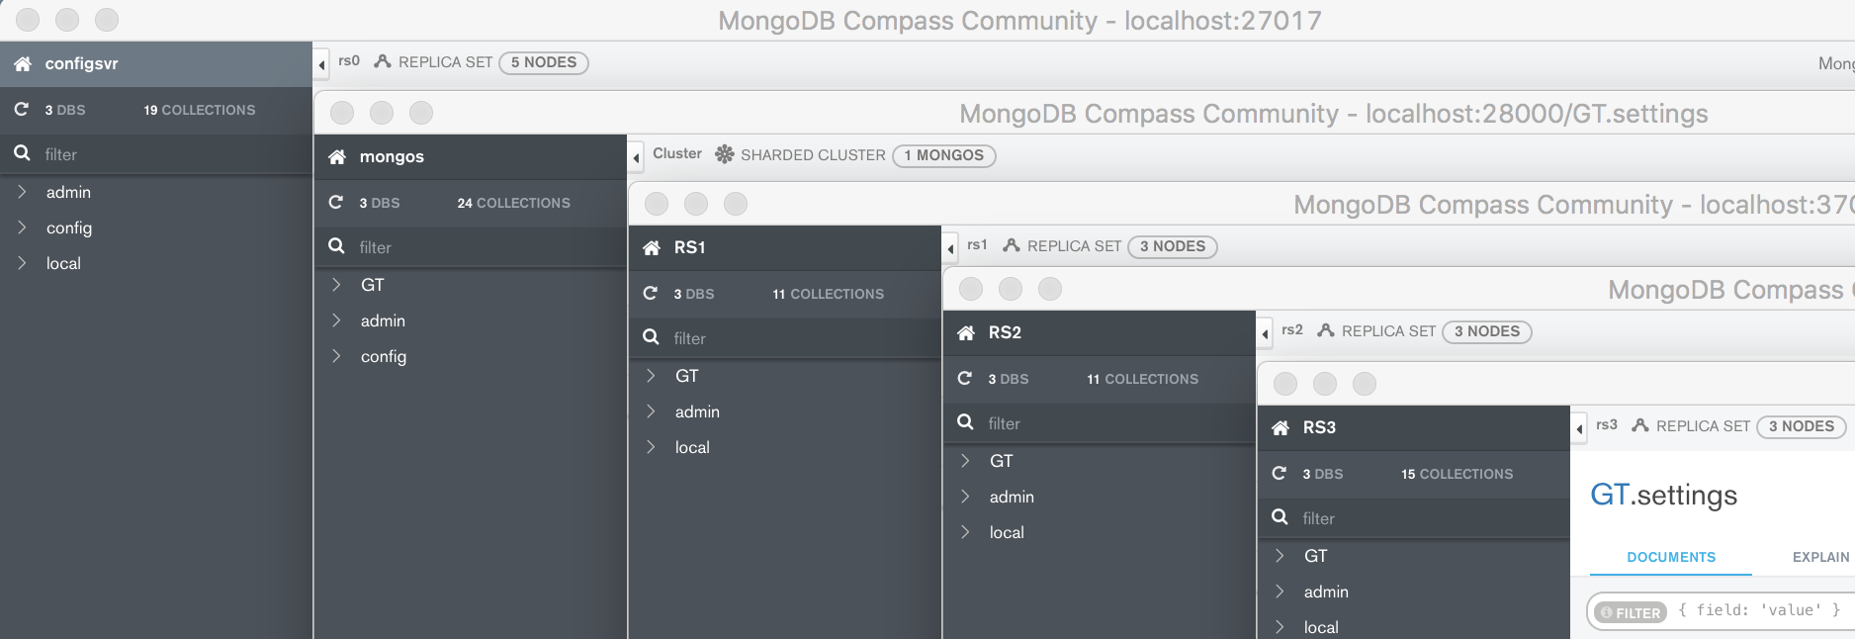
MongoDB Compass

Slide 18
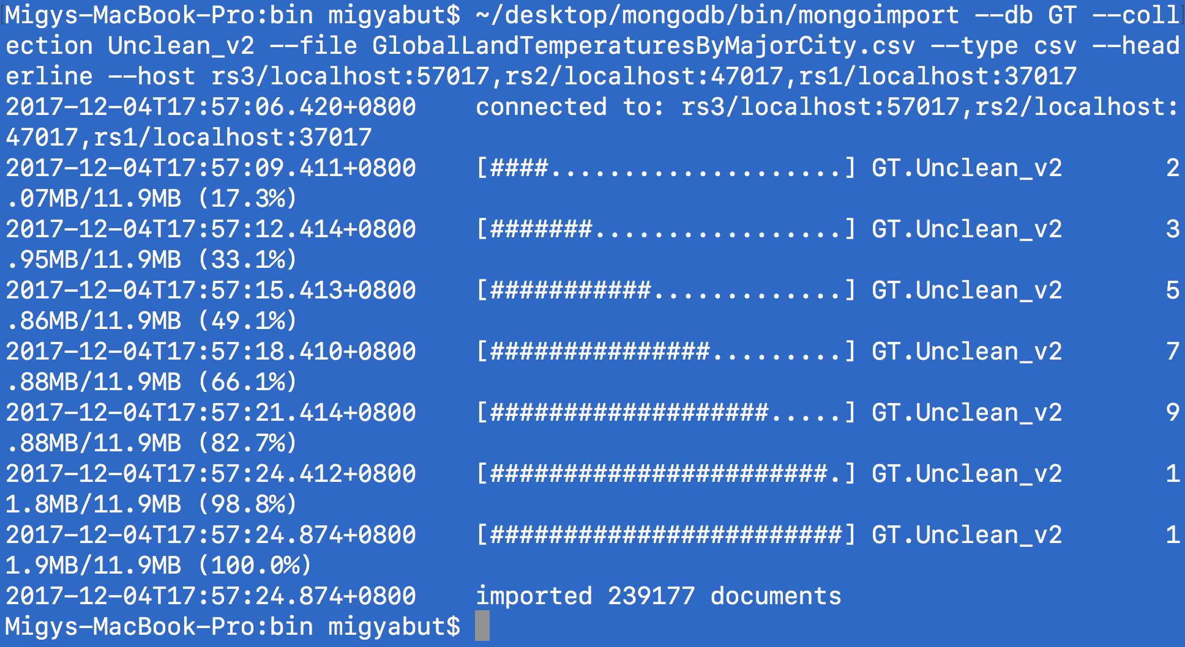
DATASET IMPORT to MongoDB
Notes:
Imported the pre-processed dataset into the replica sets
Went to the bin folder of mongodb then used mongoimport
--db GT is for the target database name
--collection is the target collection name
--file filename –host target shardservers
--type .csv file type
--headerline

Slide 19
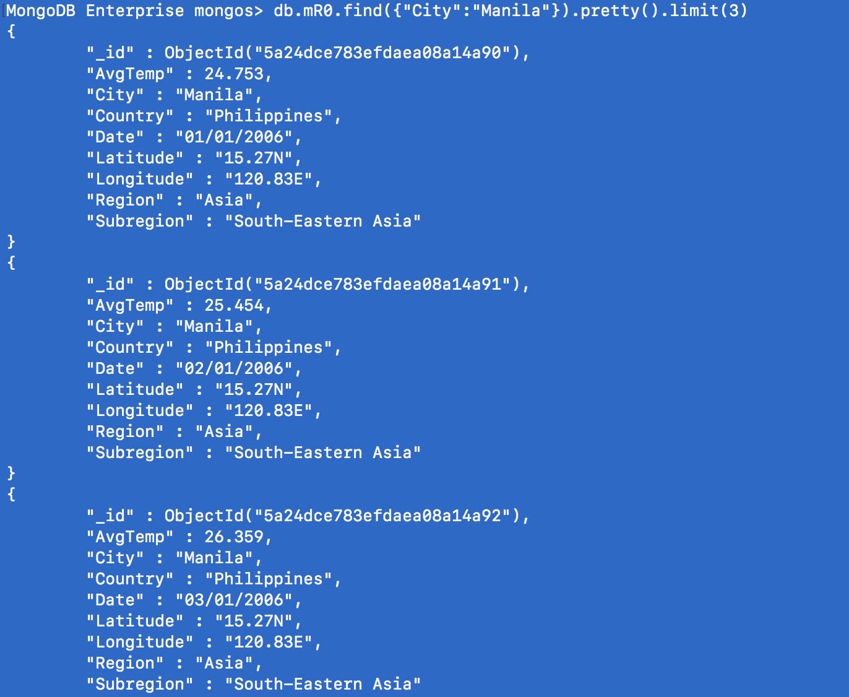
Output
(test query)
Notes:
Imported dataset into mongodb : mongos> query

Slide 20
mapReduce Test
mapReduce Track 1:
db.mR0.mapReduce(
function(){emit ({"Country": this.Country, "City": this.City},
{"Number_of_Months": 1, "Temperature_Sum": this.AvgTemp});},
function(key, values){mR1 = {"Number_of_Months": 0, "Temperature_Sum" : 0}; values.forEach(function(value){ mR1.Number_of_Months += value.Number_of_Months; mR1.Temperature_Sum += value.Temperature_Sum;});
return mR1;},
{"out": "mR1", "finalize": function(key, newTemp)
{newTemp.Avg_Temperature = newTemp.Temperature_Sum/newTemp.Number_of_Months;
return newTemp;}})
Notes:
mongoDB reflects itself on compass

Slide 21
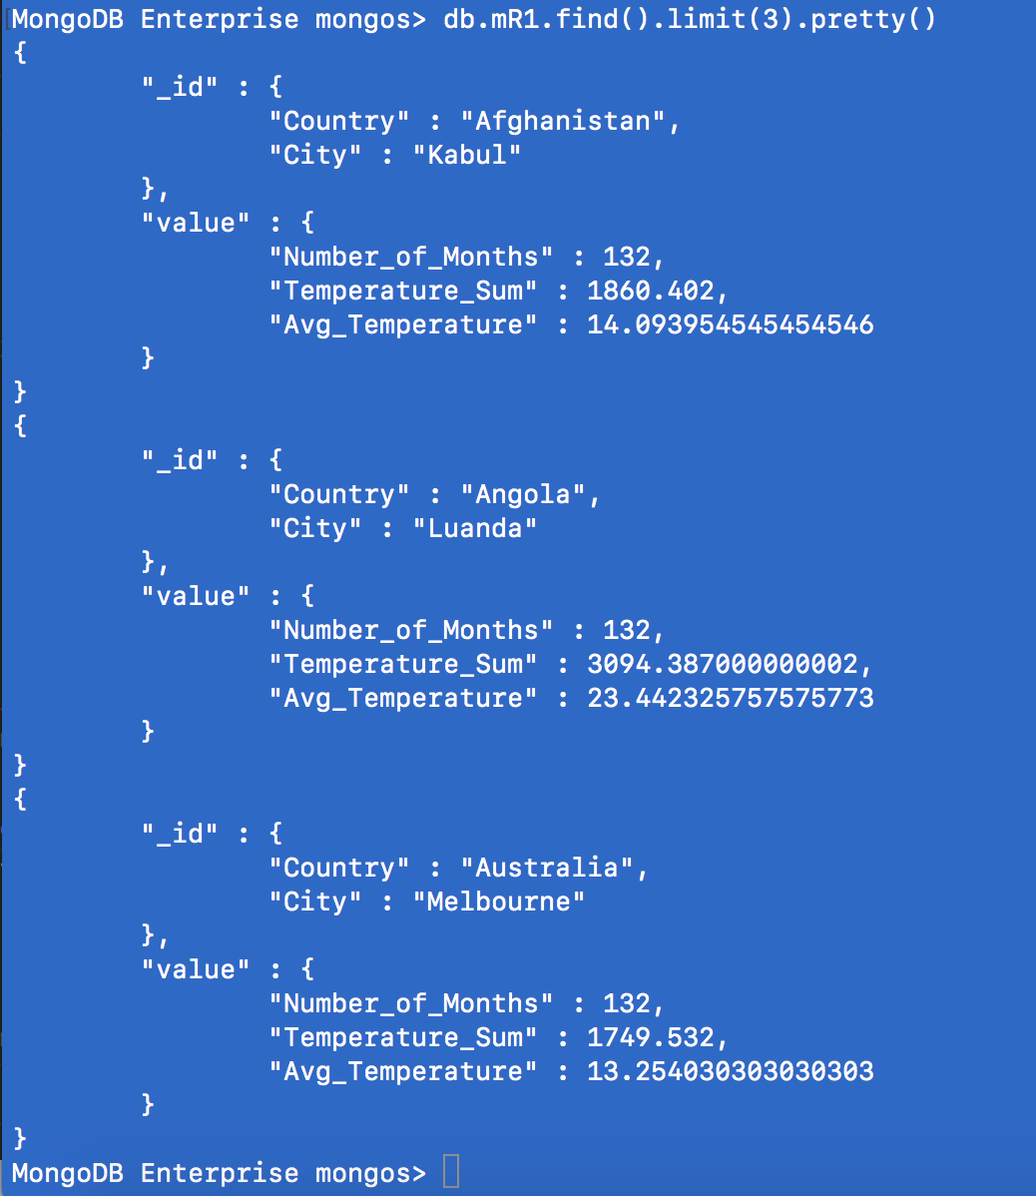
mapReduce
Output: Track 1

Slide 22
mapReduce Test
mapReduce Track 1.1:
var mFunc = function (){ emit ({"Country": this._id.Country, "City": this._id.City, "Temperature_Sum": this.value.Avg_Temperature}, 1);}
var rFunc = function(){return 0;}db.mR1.mapReduce(mFunc,rFunc,
{out:"mR2"})

Slide 23
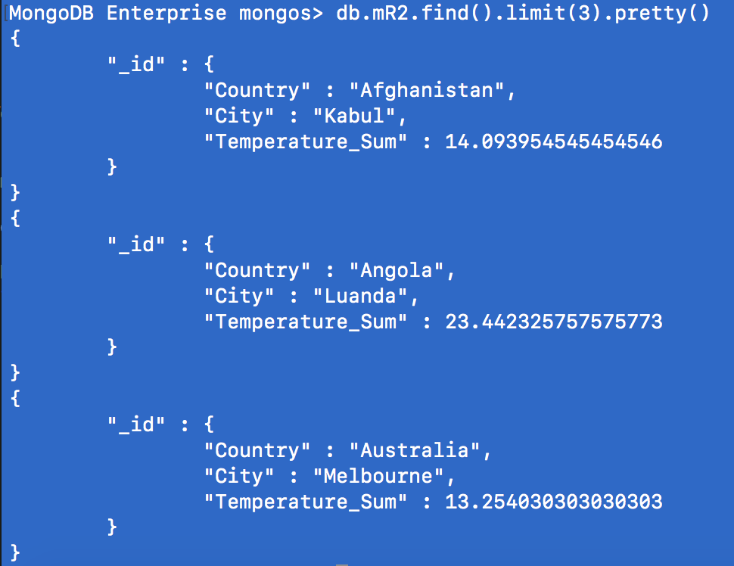
mapReduce
Output: Track 1.1:

Slide 24
mapReduce Test
mapReduce Track 2:
db.mR0.mapReduce(
function(){emit({"City": this.City},{"count":1, "temp": this.AvgTemp});},
function(key, values)
{var value = {"count":0, "temp":0};
for (i=0; i<values.length; i++)
{value.count += values[i].count;
value.temp += values[i].temp;}
return value;},
{"out":"mR4","query": {Date: /2016/},
"finalize": function(key, values)
{values.average = values.temp / values.count;
return values;}})

Slide 25
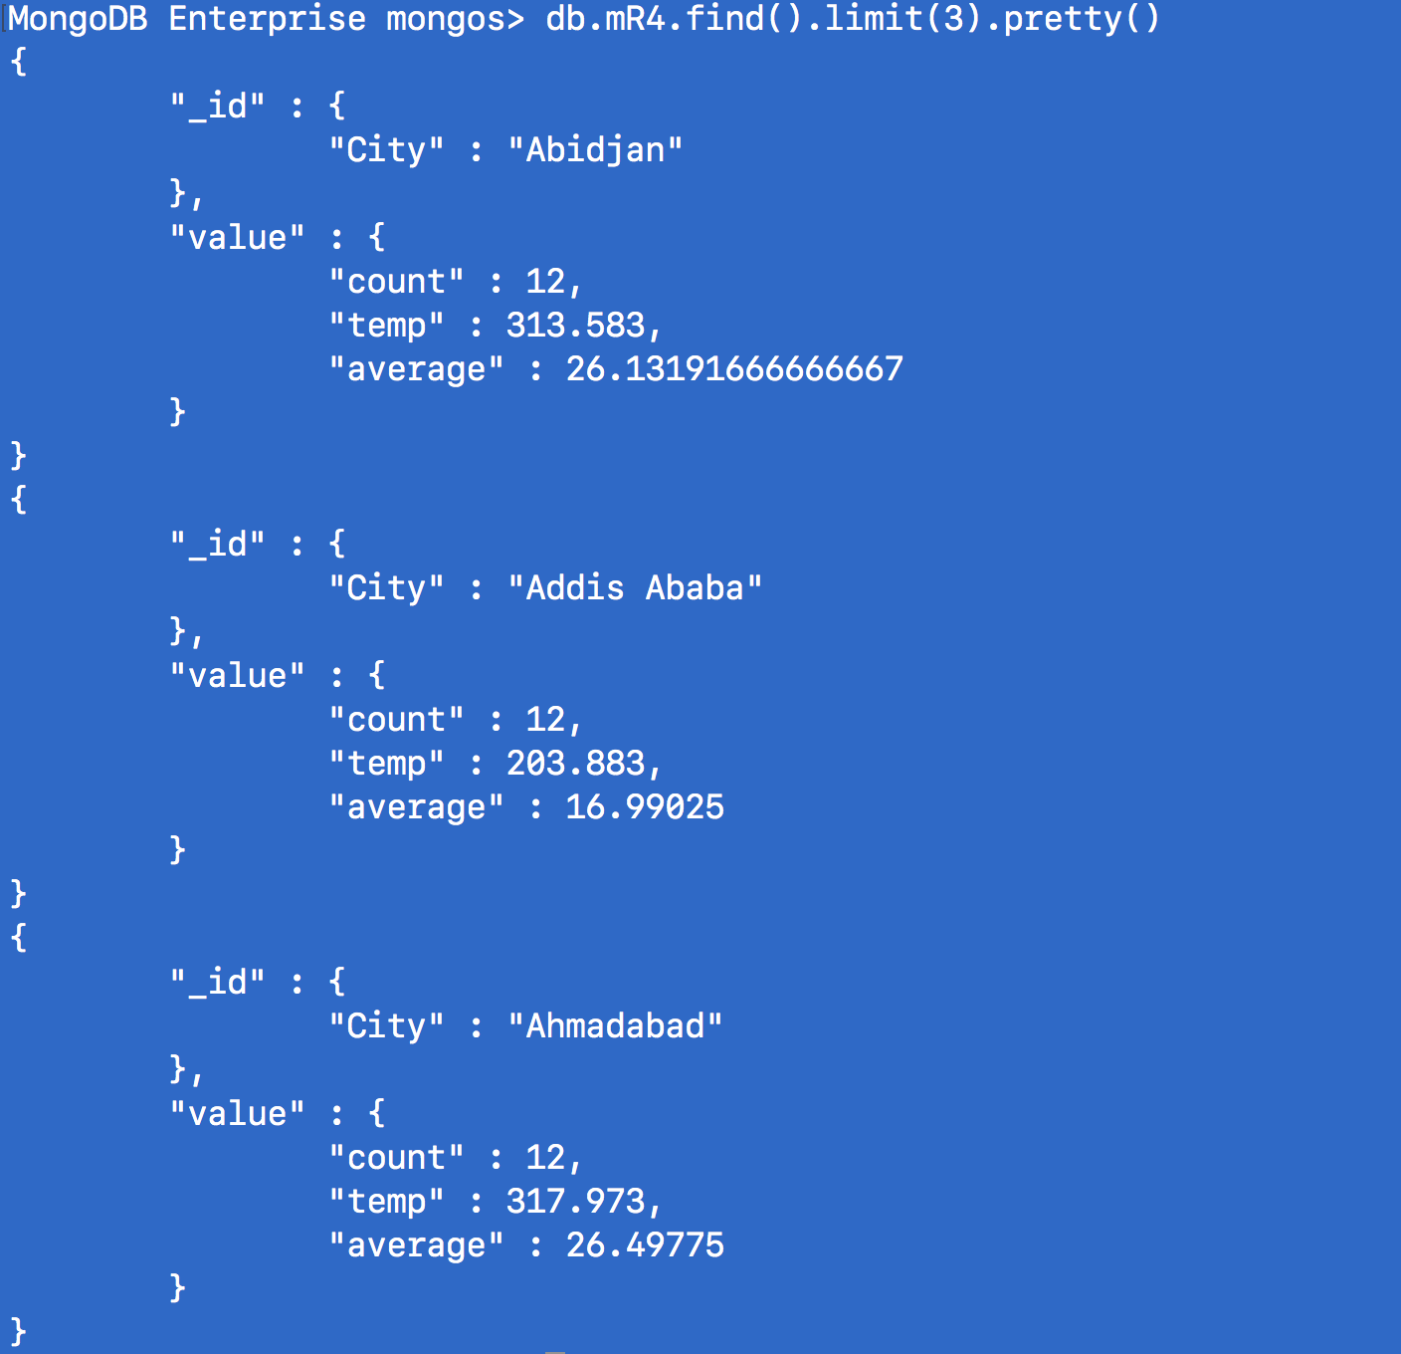
mapReduce
Output: Track 2.1:

Slide 26
mapReduce Test
mapReduce Track 2.1:
var mFunc = function ()
{ emit ({"City": this._id.City, "Year": "2016", "Average_Temperature": this.value.average}, 1);}
var rFunc = function(){return 0;}db.mR4.mapReduce(mFunc,rFunc,
{out:"mR5"})

Slide 27
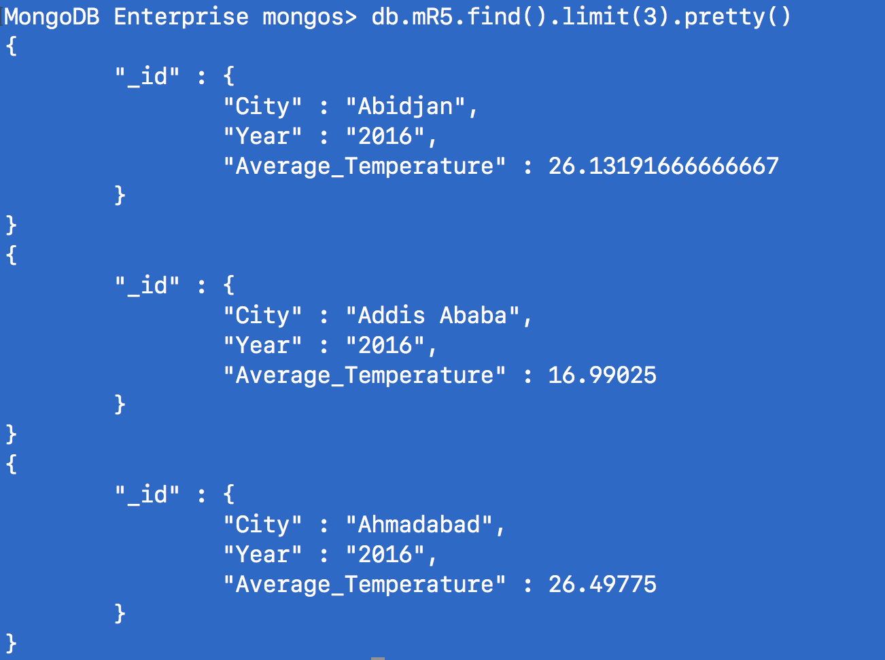
mapReduce
Output: Track 2.2:

Slide 28
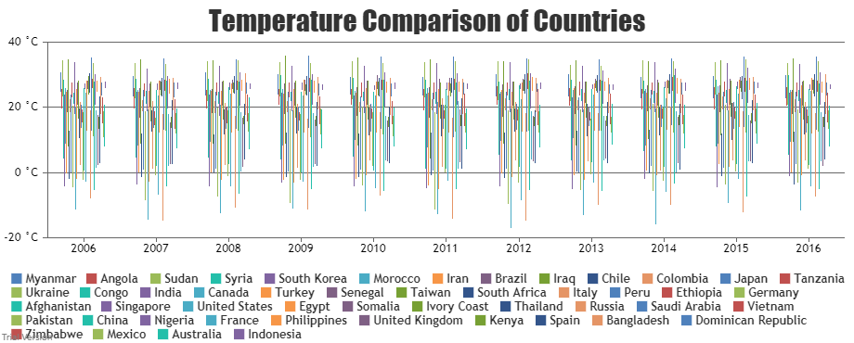

Slide 29
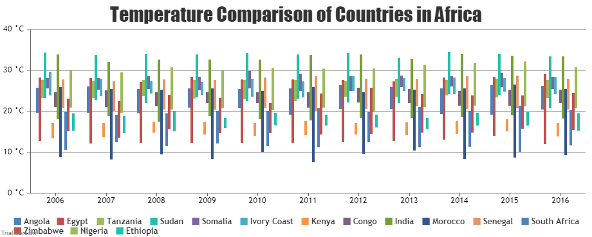

Slide 30
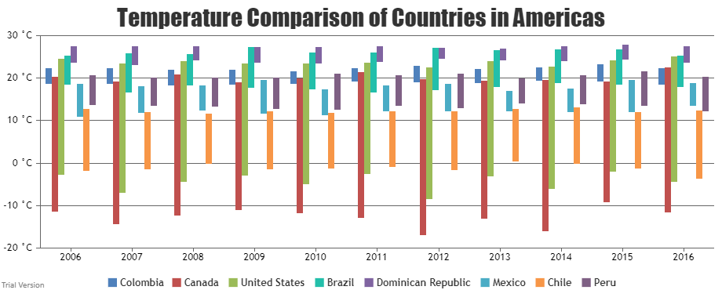

Slide 31
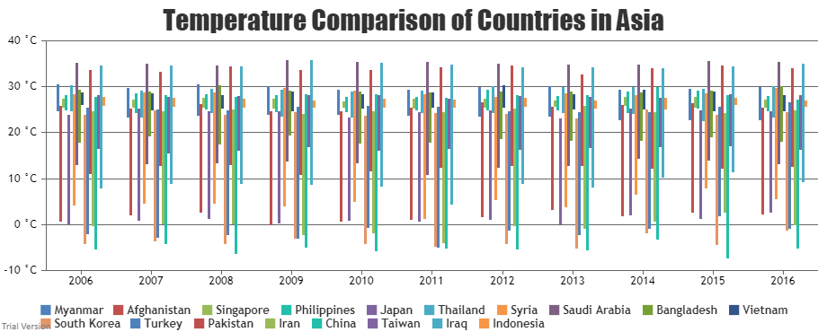

Slide 32
